Slide 1
Phase II
Finding Value, as we develop a Vaccine.
DATA 606
Nick Calomeris

Slide 2




Determine a stock’s intrinsic Value
Piotroski’s F-Score.

Slide 3
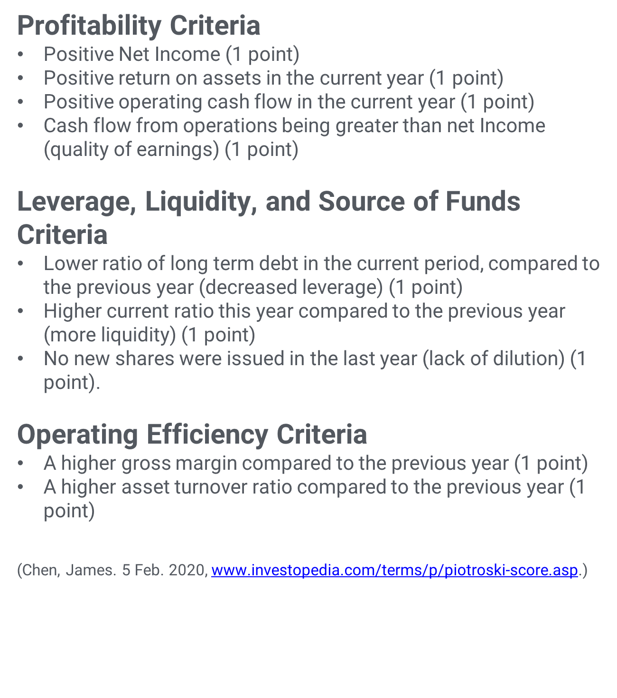
Piotroski’s F-Score.

Slide 4
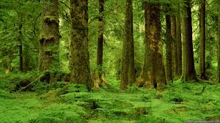
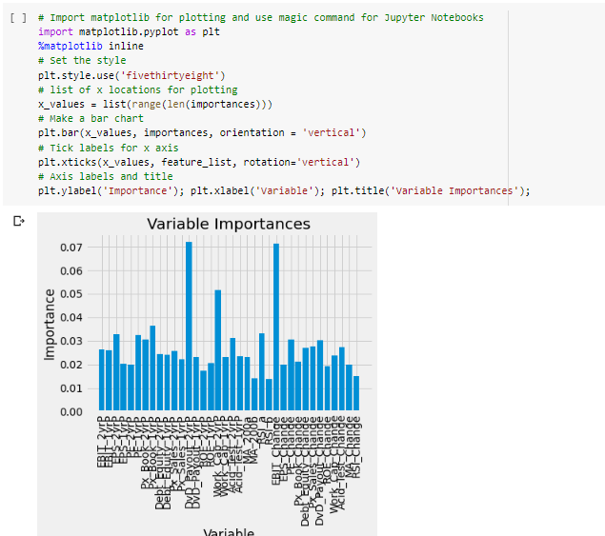
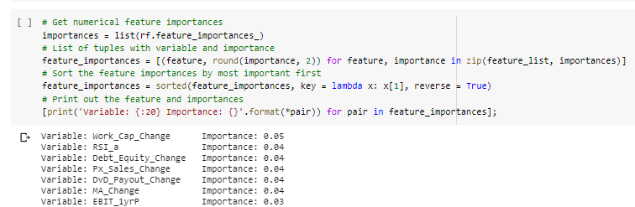
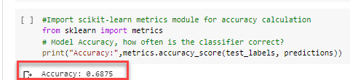
Random Forest.

Slide 5
